Slide 1


iWitness
Team Name : Egan
Team No: 20Team No : 20

Slide 2
The Concept
(Citizen Journalism Platform for local events)
An application to help mass people to access geo location based public health related information.

Slide 3
The Features
Promoting Citizen Journalism
Users post photos with news summary along with geo co-ordinates
We display the event count on a map of Bangladesh (and then distribute the news division wise with markers)
Web interface for displaying tracks in Google Map
People can vote up and down
Unique android device ID can help us get rid of abusing users

Slide 4
What we developed in GDG
Wireframe for features
Graphics Sample Layout
Planning and Revising the Idea
Planned the Entire Architecture
Ex.

Slide 5
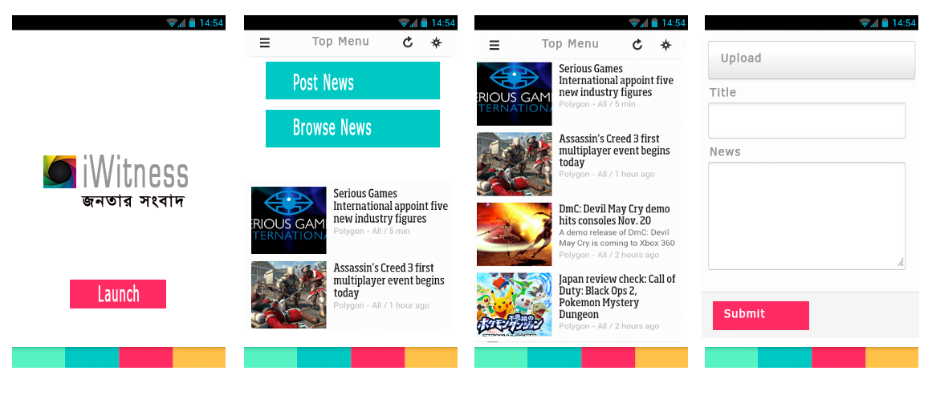
What we developed in GDG

Slide 6
Final Vision
The Android App for public use
The Administrative Server
Administrative Server will have a Google Map interface with event location pointersEx.

Slide 7
Supports We Need
Support from A2i for final deployment

Slide 8
Team Details
Md. Minhajul Abedin (minhajcsdu@gmail.com)
M A Hossain Tonu (mahtonu@gmail.com)
Abu Ashraf Masnun (masnun@gmail.com)
http://github.com/mahtonu

